Slide 1

Go, Change the World
Experiential Learning Presentation
Microstrip Patch Antenna for Breast Cancer Detection

Slide 2
PROBLEM STATEMENT
Go, Change the World
Breast cancer remains a leading cause of death, often due to delayed diagnosis caused by fear, stigma, and limited access to regular screenings. Many individuals avoid hospitals, leading to missed opportunities for early detection when treatment is most effective.

Slide 3
INTRODUCTION
Go, Change the World
Global Concern: Breast cancer remains one of the top causes of mortality among women globally.
Need for Early Detection: As cancer progresses, the probability of effective treatment and survival drastically decreases—making early detection essential.
Limitations of Conventional Methods: Existing imaging techniques like Mammography, MRI, CT, and
PET scans have drawbacks such as ionizing radiation, high cost, limited portability, and reduced effectiveness in dense breast tissues.
Emerging Alternative – Microwave Imaging (MI):
Uses non-ionizing radiation, ensuring patient safety.
Offers cost-effectiveness, portability, and ease of use.
Works on the principle of dielectric contrast between healthy and cancerous tissues.
Role of Microstrip Patch Antenna:
Acts as a transmitter and receiver in microwave imaging systems.
Favored for its light weight, compact size, ease of fabrication, and low cost.
Can be designed using flexible (textile) or rigid (non-flexible) substrates, making it suitable for wearable biomedical applications.

Slide 4
Literature Review-1
Go, Change the World
PAPER TITLE | AUTHORS AND PUBLICATION DETAILS | SUMMARY | MERITS | DEMERITS
Breast Cancer Detection Using a Miniaturized mm Wave Antenna Sensor October 25, 2022 | Authors: Chinmoy Das, Mostafa Zaman Chowdhury (Senior Member, IEEE), Yeong Min Jang (Member, IEEE) Published in: IEEE Access | The study proposes a compact mmWave antenna (5×5 mm²) operating at 33.29 GHz for breast cancer detection and 5G applications. The antenna achieves high performance: 91.46% radiation efficiency and 6.64 dB gain on a Rogers RT 5880 substrate. It can detect breast tumors as small as 1 mm by analyzing shifts in the S11 reflection coefficient. | Dual-purpose utility: Enables both breast cancer detection and high-speed 5G communication, maximizing its applicability. High precision and safety: Detects tumors as small as 1 mm while maintaining SAR compliance, making it efficient and safe for biomedical use | Complex fabrication: The mmWave frequency band (>30 GHz) demands specialized and expensive manufacturing and testing tools. Lack of real-world validation: The study relies on simulation with simplified tumor models and lacks physical prototyping or clinical testing.

Slide 5
Literature Review-2
Go, Change the World
PAPER TITLE | AUTHORS AND PUBLICATION DETAILS | SUMMARY | MERITS | DEMERITS
Breast Cancer Diagnosis Using a 33 GHz Patch Antenna and Millimeter-Wave Spectroscopy December 2023 | Authors: İremnur Duru, Nurhan Güneş, Timuçin Emre Tabaru Affiliation: Department of Electrical and Electronics Engineering, Sivas University of Science and Technology, Türkiye | A 33 GHz patch antenna on RT5880 substrate enables mmWave breast imaging. Four antennas improve tumor localization through multi-angle detection. Tumors cause S-parameter shifts; key frequencies identified via Euclidean analysis. Compact design achieves low VSWR (<2) and ~2 dBi gain for portable use. | High spatial resolution with safe radiation: Millimeter-wave imaging provides fine detection without ionizing radiation risks. Improved localization capability: Multi-antenna setup and S-parameter vector analysis enhance tumor position detection. | Shallow penetration depth: mmWave signals have limited ability to penetrate deeply into tissue, which may affect detection of deep-seated tumors. Simulation-only validation: The system lacks real-world clinical trials and relies on simplified tumor models, reducing immediate practical applicability.

Slide 6
Literature Review-3
Go, Change the World
PAPER TITLE | AUTHORS AND PUBLICATION DETAILS | SUMMARY | MERITS | DEMERITS
A Flexible UWB Antenna for Wearable Technologies Application December 2023 | Authors: İremnur Duru, Nurhan Güneş, Timuçin Emre Tabaru Affiliation: Department of Electrical and Electronics Engineering, Sivas University of Science and Technology, Türkiye | The UWB antenna operates in the 3.1–10.6 GHz range for wearable tech applications. It uses a Kapton Polyimide substrate for flexibility and durability. Maintains stable return loss and radiation under bending and deformation. Suitable for body-worn systems due to mechanical resilience. | High flexibility with stable performance: Works effectively under bending, ideal for wearable use. Conformal design: Can be integrated into body surfaces or clothing without losing signal quality | No biological testing: Lacks validation near or on actual human tissue. Limited comparison: Doesn't provide sufficient performance benchmarking against traditional rigid antennas.

Slide 7
OBJECTIVES
Go, Change the World
Enable Early Detection: Facilitate the identification of breast cancer at its initial stages to improve treatment outcomes.
Ensure Non-Invasive Diagnosis: Utilize RF signals to eliminate the need for painful biopsies or radiation-based imaging.
Promote Compact and Flexible Design: Develop a sensor suitable for integration into wearable and portable medical devices.
Enhance Diagnostic Accuracy: Distinguish between healthy and cancerous tissues based on their unique RF characteristics.
Offer Cost-Effective Solutions: Minimize reliance on high-cost diagnostic tools such as MRI and CT scans.
Adopt a Simulation-Based Approach: Leverage CST software for precise modeling and tissue response analysis.
Support Future Clinical Expansion: Lay the groundwork for future enhancements and clinical deployment of the system.

Slide 8
Millimeter Wave Spectroscopy
Go, Change the World
Millimeter wave spectroscopy uses high-frequency signals (30–300 GHz) to detect changes in tissue properties.
In this project, a 33 GHz microstrip patch antenna is used to identify tumors based on how breast tissues reflect mmWave signals.
Working Principle: mmWave signals interact with breast tissue
Tumors alter the dielectric properties
Changes in S11 (return loss) indicate tumor presence
Enables detection through non-invasive scanning
Advantages
High Resolution: Detects small tumors due to short wavelengths
Non-Invasive: Safe, non-ionizing radiation
Compact & Wearable: Ideal for portable healthcare devices
Real-Time Monitoring: Enables continuous scanning outside clinics

Slide 9
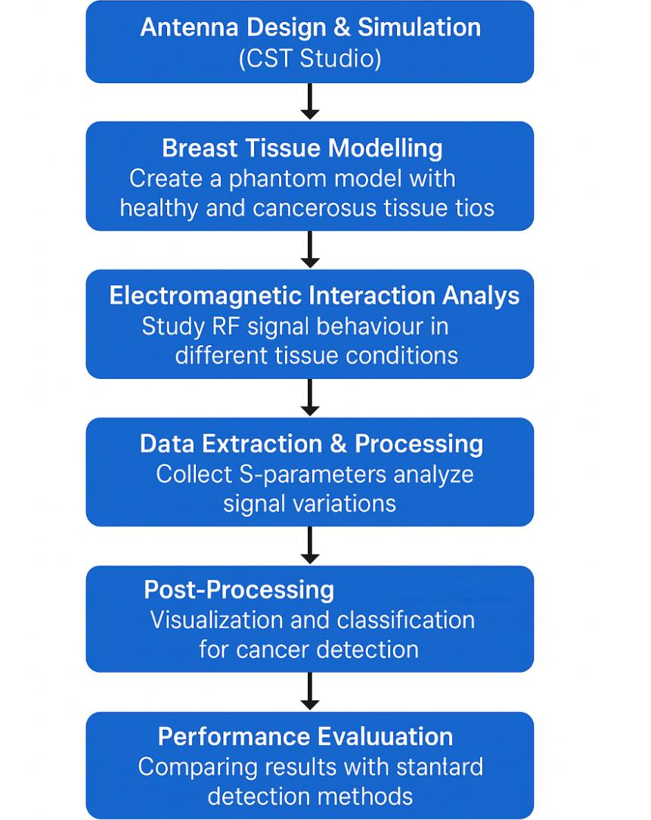
FLOW CHART
Go, Change the World

Slide 10
Methodology
Go, Change the World
Antenna Design & Simulation (CST Studio):
A 33 GHz microstrip patch antenna was designed using CST Microwave Studio. The antenna was built on a Rogers RT5880 substrate with a thickness of 0.508 mm to ensure minimal signal loss and high-frequency resolution. Antenna performance metrics such as return loss (S11), gain, and VSWR were analyzed.
Breast Tissue Modelling:
A multilayered breast phantom model was constructed, simulating skin, fat, fibro-glandular tissue, and a tumor. Each layer was assigned realistic dielectric properties to mimic actual tissue behavior under RF exposure.
Electromagnetic Interaction Analysis:
The system setup included four antennas positioned at 90° intervals around the breast phantom to ensure full angular coverage.Electromagnetic simulations were conducted for three scenarios: without tumor, with tumor, and with tumor at different locations

Slide 11
Methodology
Go, Change the World
Data Extraction & Processing:
Scattering parameters (S-parameters) were extracted from each simulation scenario. Notable shifts in S11 and changes in vector profiles were recorded to assess the presence and position of tumors.
Post-Processing & Analysis:
The Euclidean distance between S-parameter vectors was calculated to quantify tissue response variations. Peaks at specific frequencies (e.g., 32.8240 GHz and 32.9280 GHz) indicated tumor presence and location. This approach enabled effective differentiation between healthy and cancerous tissue.
Performance Evaluation:
The antenna’s performance was evaluated based on key parameters including gain (~2 dBi), return loss, and VSWR (<2). Although limited to simulation, the system demonstrated high potential for accurate and non-invasive breast cancer detection.

Slide 12
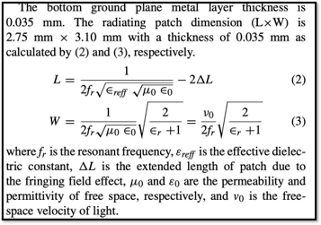
Formulas
Go, Change the World

Slide 13
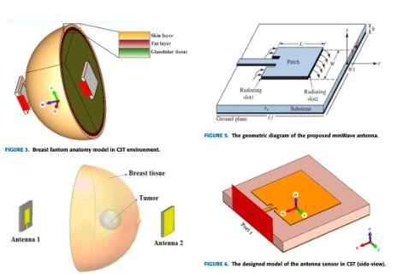
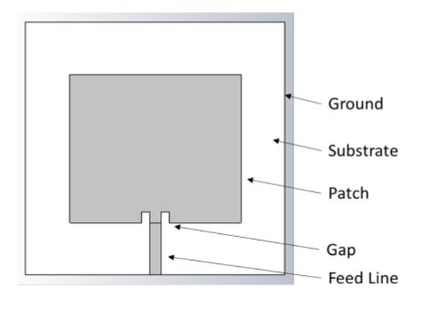
Diagram
Go, Change the World

Slide 14
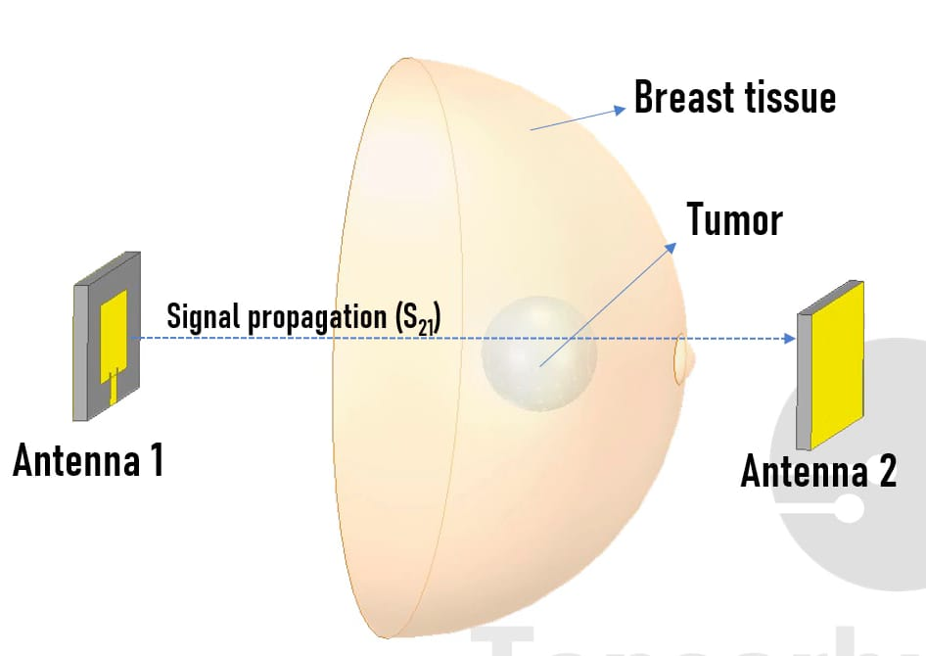
Diagram
Go, Change the World

Slide 15
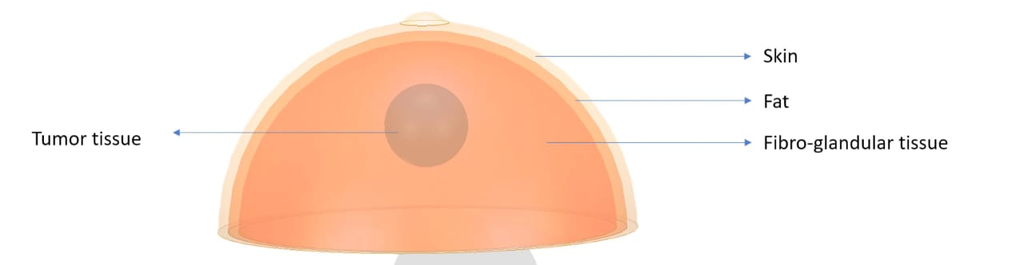
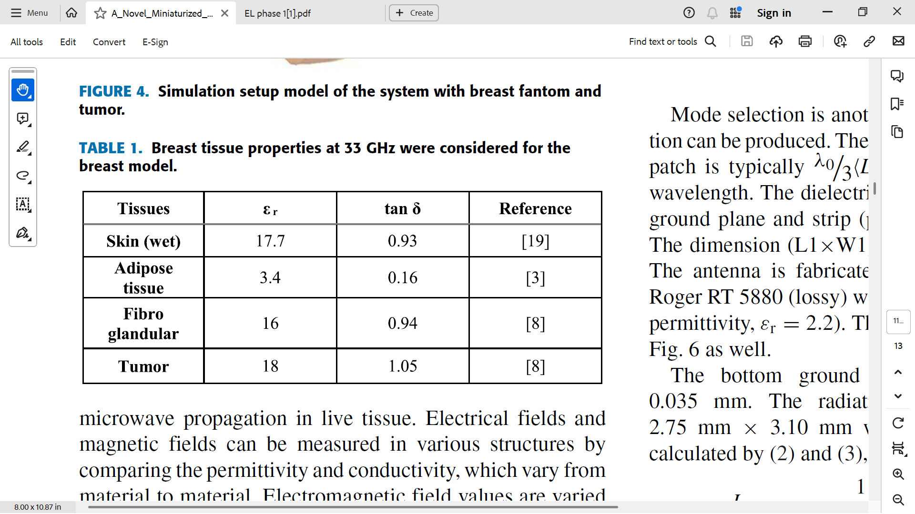
ELECTRICAL MATERIAL PROPERTIES
OF BREAST TISSUE
Go, Change the World

Slide 16
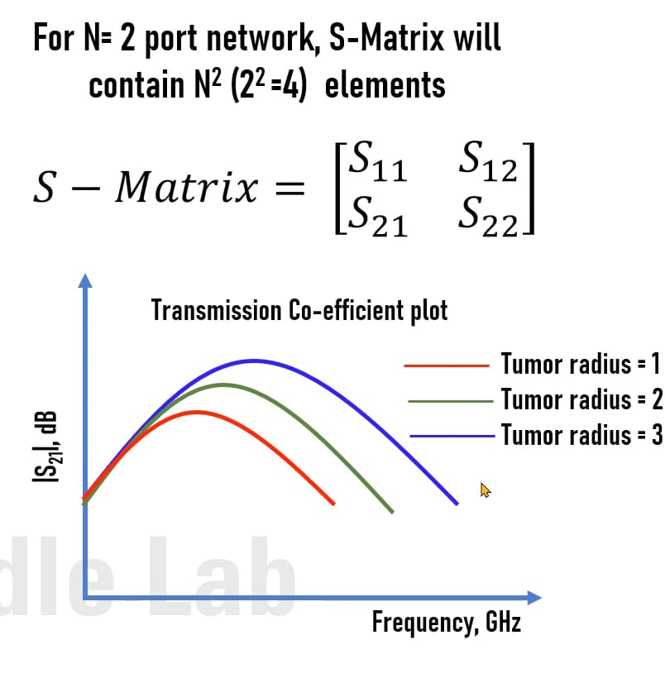
OBTAINED GRAPH
Go, Change the World

Slide 17
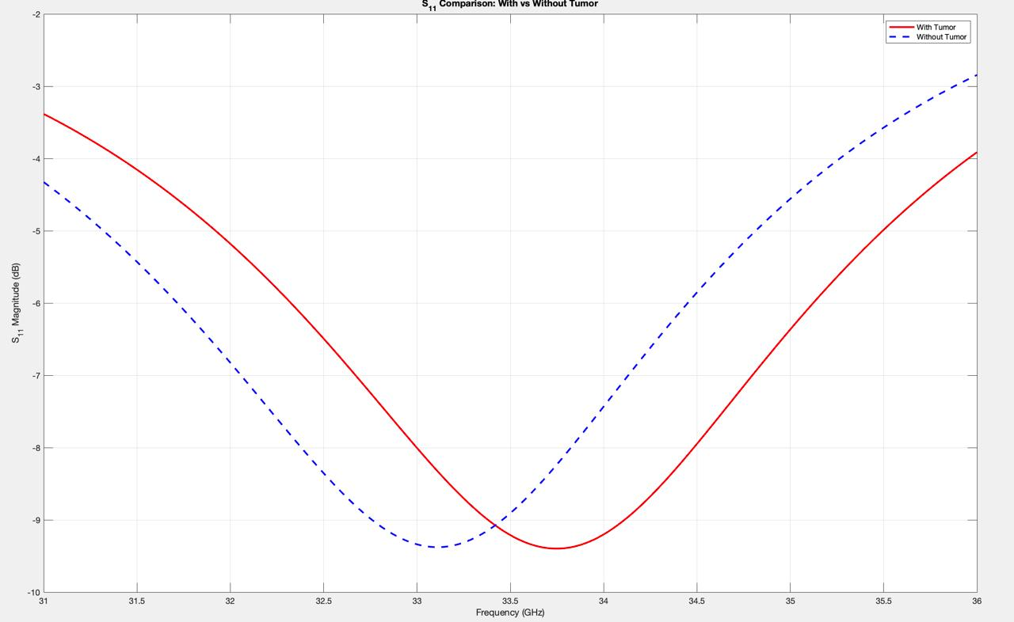
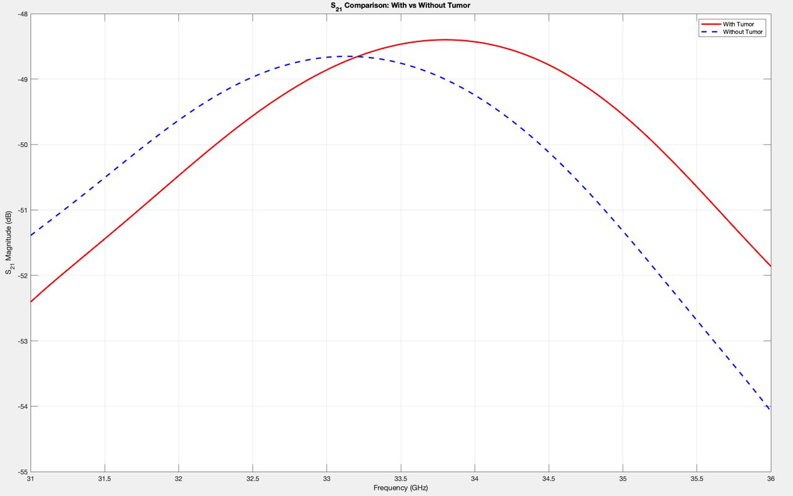
MATLAB RESULTS
Go, Change the World
S11 PLOT
S21 PLOT

Slide 18
RESULTS
Go, Change the World
S11 Observation with Tumor Presence
Observation: The resonant frequency shifted to the right (higher frequency).The gain decreased compared to the healthy tissue case.
Reason:
The tumor changes the dielectric properties of the breast tissue (higher water content and permittivity).
This alters the electromagnetic field distribution, causing : Impedance mismatch → frequency shift
More signal absorption/scattering → gain reduction
S21 Observation with Tumor Presence
Observation:The resonant frequency shifts to the right (higher frequency).The gain (S21 magnitude) increases when the tumor is present.
Reason:
The tumor changes the local dielectric constant, affecting wave propagation through the tissue.
This alters the transmission path : Higher permittivity in the tumor region can cause reduced attenuation or constructive interference, leading to increased signal transmission (S21).
The frequency shift is due to the overall dielectric mismatch, causing a change in the resonant condition of the system.

Slide 19
RESULTS VSCODE
Go, Change the World
S11 Resonance Analysis
Without Tumor: 33.20 GHz | S11 = -9.30 dB
With Tumor: 33.70 GHz | S11 = -9.40 dB
Frequency Shift = 0.50 GHz | Depth
Difference = 0.10 Db
S21 Transmission Analysis
Without Tumor: 33.20 GHz | S21 = -48.70 dB
With Tumor: 33.60 GHz | S21 = -48.40 dB
S21 Difference = 0.30 dB
RESULT: Tumor Detected based on S11 and S21 analysis.

Slide 20
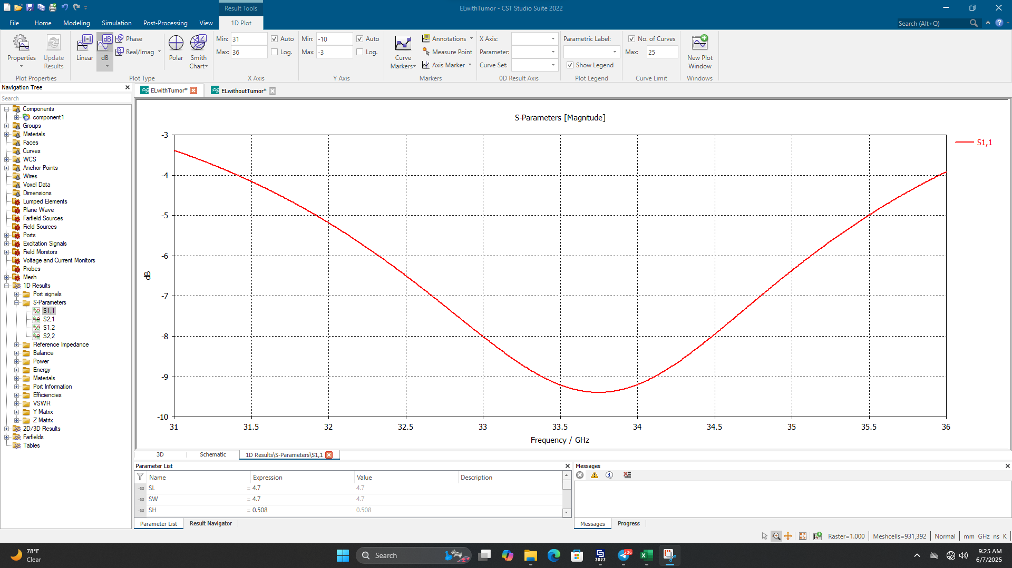
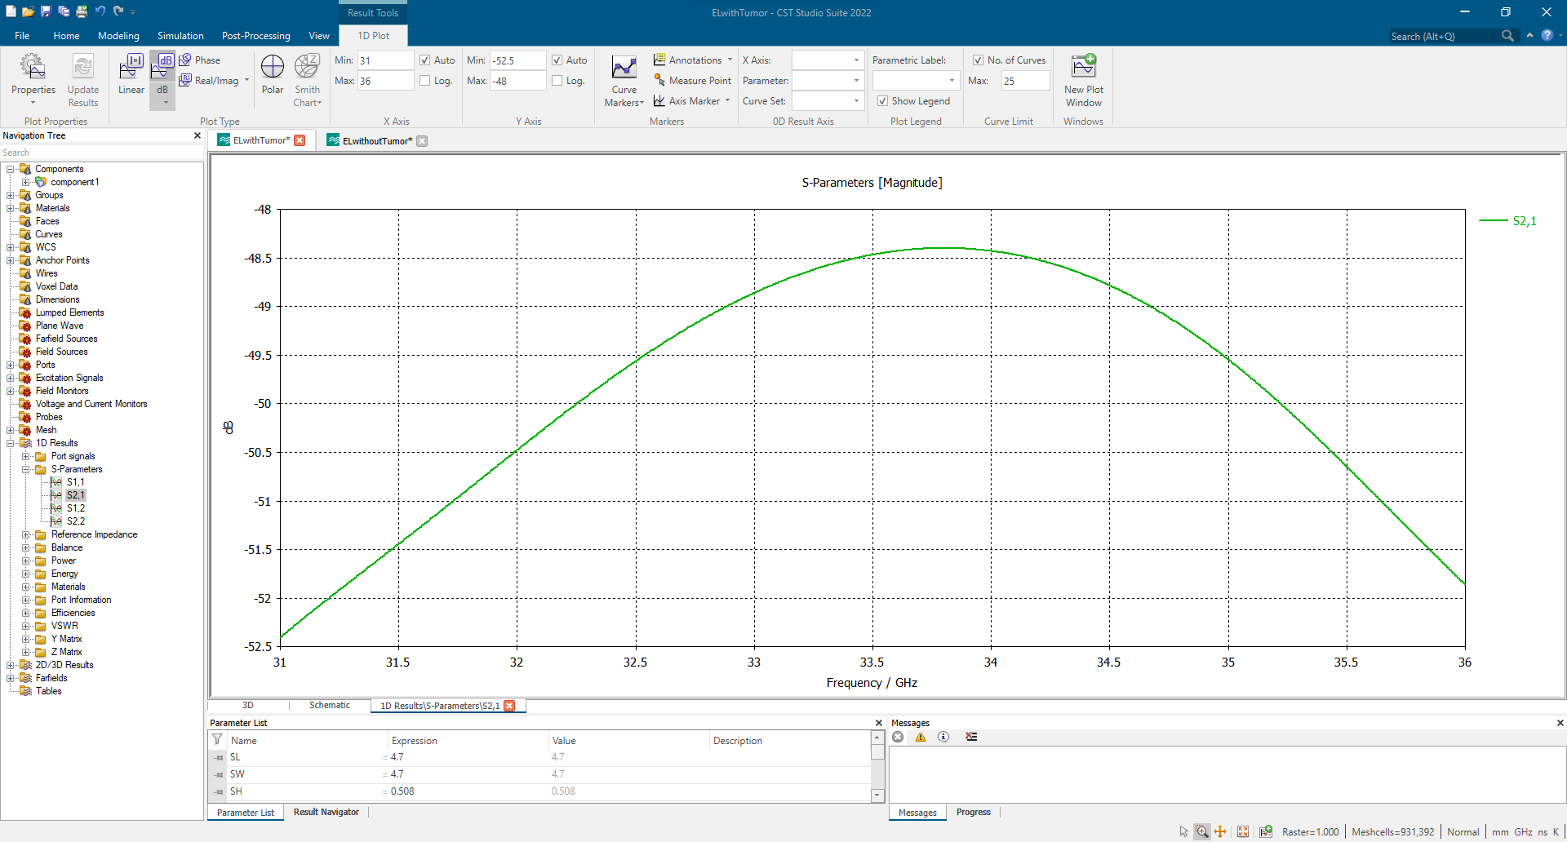
CST STUDIO RESULTS
Go, Change the World
S11 WITH TUMOR
S21 WITH TUMOR

Slide 21
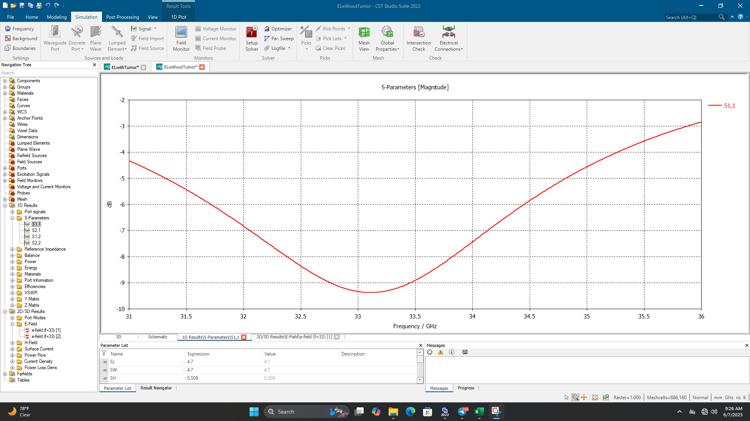
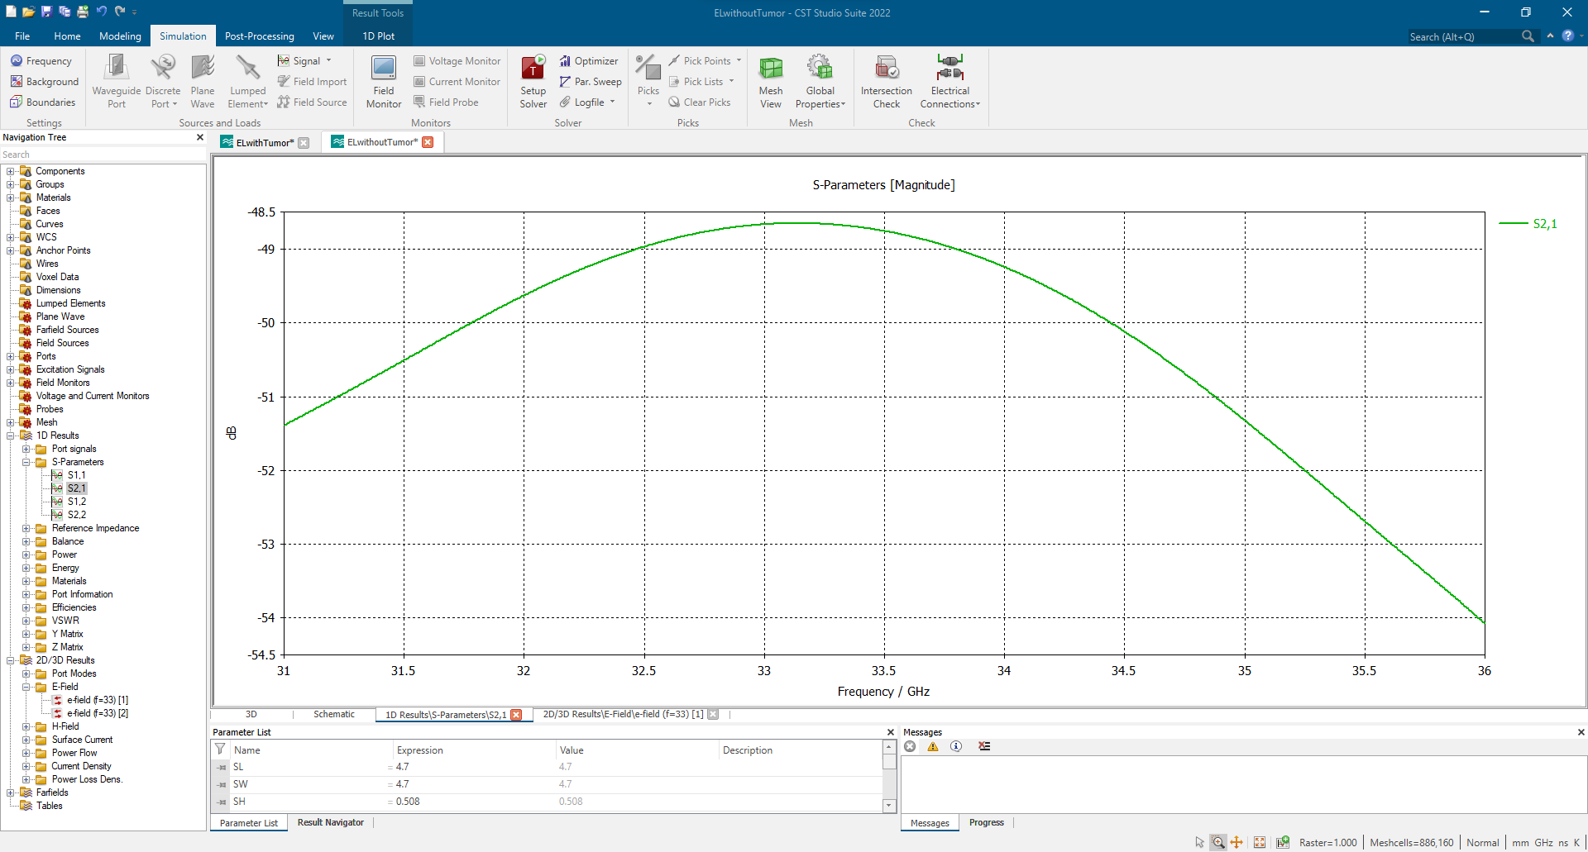
CST STUDIO RESULTS
Go, Change the World
S11 WITHOUT TUMOR
S21 WITHOUT TUMOR

Slide 22
References
Go, Change the World
​
1] A. Omar, N. Ibrahim, and A. Bakr, "Female medical students’ awareness, attitudes, and knowledge about early detection of breast cancer in Syrian Private University, Syria," Heliyon, vol. 6, no. 4, 2020.
[2] Union Internationale Contre le Cancer, Classification clinique des tumeurs malignes du sein: projet 1956 = Clinical stage classification of malignant tumors of the breast. Paris, France: Union Internationale Contre le Cancer, 1956.
[3] M. Kaur and S. Goyal, "Microstrip patch antenna design for early breast cancer detection," Int. J. Recent Technol. Eng. (IJRTE), vol. 8, no. 6, pp. 2698–2705, 2020.
[4] C. A. Balanis, Antenna Theory: Analysis and Design, 3rd ed. Hoboken, NJ, USA: Wiley, 2005.
[5] R. Çaliskan, S. S. Gültekin, D. Uzer, and O. Z. R. Dündar, "A microstrip patch antenna design for breast cancer detection," Procedia - Soc. Behav. Sci., vol. 195, pp. 1703–1712, 2015.
[6] H. V. Kumar, "Design of microstrip patch antenna to detect breast cancer," ICTACT J. Microelectron., vol. 6, no. 1, pp. 893–896, 2020.

